Slide 1

Tutorial 2: NoSQL & Spark
Ao Zhang
aozhang@u.nus.edu

Slide 2
Question 1a
Compare ACID and BASE. Why do NoSQL systems choose BASE?
ACID = Atomicity, Consistency, Isolation, and Durability
BASE = Basically Available, Soft state, Eventually consistent

Slide 3
Solution 1a
Atomicity: Each transaction is "all or nothing” (i.e. succeed completely or fail completely).
Consistency: Any transaction will bring the database from one valid state to another.
Isolation: Ensures that concurrent execution of transactions leaves the database in the same state that would have been obtained if the transactions were executed sequentially.
Durability: Once a transaction has been completed, it will remain so, even in the event of power loss, crashes, or errors.

Slide 4
Solution 1a
Basically Available: Reading and writing operations are available as much as possible, but without consistency guarantees (e.g. read may not get the latest updated value).
Soft state: The state of the system is always ‘soft’ or changing with inputs, until it reaches ‘eventual consistency’.
Eventually consistent: The system will eventually become consistent (e.g. multiple reads eventually return the same value).

Slide 5
Solution 1a
The idea is that by giving up ACID constraints, one can improve performance.

Slide 6
Question 1b
What is a practical reason to prefer horizonal scalability over vertical scalability?
Less expensive, using commodity servers.

Slide 7
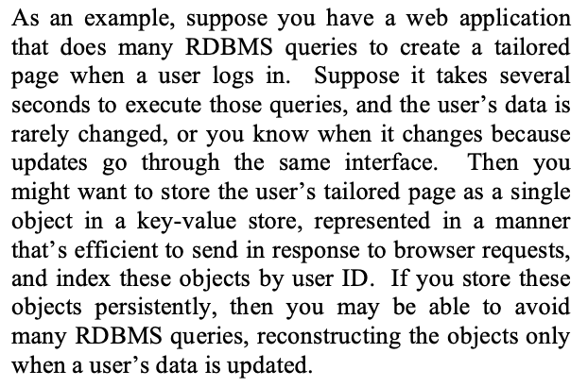
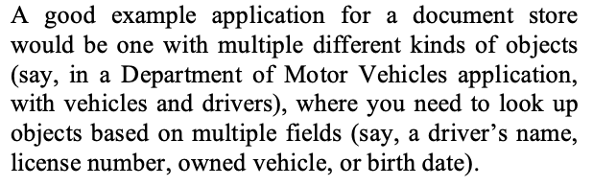
Question 1c
In the mentioned paper, they list a suitable application for key-value stores:
And for document stores:
Discuss some factors that make these applications suitable for key-value stores and document stores respectively.

Slide 8
Question 1c
Key-value store:
Improves scalability and efficiency – writing or reading user pages is faster.
No need for complex queries or based on the content of user pages – just reads and writes.
May be acceptable for user pages to be slightly stale – then eventual consistency is acceptable
Document store:
Flexible schema may be beneficial (e.g. special types of vehicles may require different sets of fields)
Unlike key-value stores, document stores allow for queries based on fields of a document

Slide 9
Question 2a
Why Spark is more suitable for iterative processing compared to Hadoop?
Spark stores most of its intermediate results in memory, making it much faster, especially for iterative processing.

Slide 10
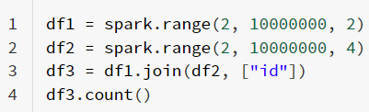
Question 2b
In the below spark code block, please indicate which lines are transformation and which lines are action. For transformation, please also indicate whether it is a narrow transformation or wide transformation.
Line 1: narrow transformation
Line 2: narrow transformation
Line 3: wide transformation
Line 4: action

Slide 11
Question 2c
In HDFS, each chunk is replicated for three times by default. In contrast, in Spark, RDD uses lineage for reliability. What is a major problem if Spark also uses replications for reliability?
Consumes a lot of memory; memory is much more scarce than disk space

Slide 12
Question 2d
Is it true that in the Spark runtime, RDD cannot reside in the hard disk?
False. RDD can also be in the disk if out of memory.

Slide 13
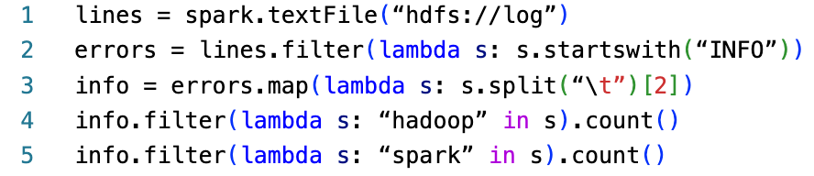
Question 2e
Explain how the following program can be sped up.

Slide 14
Question 2e
Explain how the following program can be sped up.
1: read RDD from HDFS
2: filter to lines starting with “INFO”
3: split by tab & extract 2nd chunk
4: Count no. of lines with ‘hadoop’
5: Count no. of lines with ‘spark’
Lines 4-5 are recomputing the RDD by re-reading it from file. So, we should add info.cache() (or info.persist()) before line 4, to cache the RDD in disk so it doesn’t have to be re-computed in line 5.

